Slide 1
Item | W0 | W1 | W2 | W3 | W4 | W5 | W6 | - | W7 | W8 | W9 | W10
[Deadline] Research Proposal | 6-11
RQ 1: Finding data sets
RQ 1: Generating a framework
RQ 2: Research mathematical foundation of NGs
RQ 2: Develop Python NG generation tool
RQ 2: Test and validate the NG generation tool
RQ 3: Literature review on Markov Chains
[Deadline] Draft Paper |  |  |  |  |  | 11-12
RQ 3: Develop Python visualization tool for NGs
RQ 3: Characterize NGs
MQ: Combine RQs
MQ: Conclude MQ
Proofread
[Deadline] Final Paper |  |  |  |  |  |  |  |  |  |  | 22-01
[Deadline] Presentation |  |  |  |  |  |  |  |  |  |  |  | 29-01

Slide 2
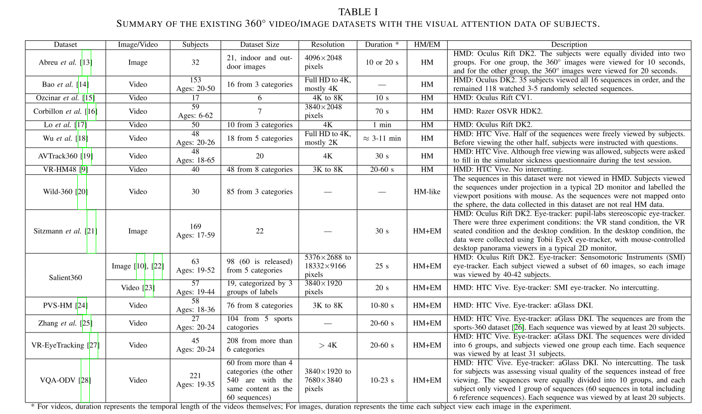

Slide 3



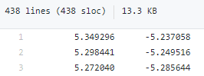
Dataset:
Paper:
40 participants
18 videos
5 categories
Unit-quaternion
X/Y/Z
https://dl-acm-org.ezproxy2.utwente.nl/do/10.1145/3192423/abs/
https://dl-acm-org.ezproxy2.utwente.nl/doi/10.1145/3083187.3083210
https://github.com/Archer-Tatsu/head-tracking
Data set:
Paper:
40 participants
48 videos
8 categories
Latitude/longitude
https://ieeexplore-ieee-org.ezproxy2.utwente.nl/abstract/document/8019351

Slide 4
Item | W0 | W1 | W2 | W3 | W4 | W5 | W6 | - | W7 | W8 | W9 | W10
[Deadline] Research Proposal | 6-11
RQ 1: Finding data sets
RQ 1: Generating a framework
RQ 2: Research mathematical foundation of NGs
RQ 2: Develop Python NG generation tool
RQ 2: Test and validate the NG generation tool
RQ 3: Literature review on Markov Chains
[Deadline] Draft Paper |  |  |  |  |  | 11-12
RQ 3: Develop Python visualization tool for NGs
RQ 3: Characterize NGs
MQ: Combine RQs
MQ: Conclude MQ
Proofread
[Deadline] Final Paper |  |  |  |  |  |  |  |  |  |  | 22-01
[Deadline] Presentation |  |  |  |  |  |  |  |  |  |  |  | 29-01

Slide 5
https://github.com/Archer-Tatsu/head-tracking
Data set:
Paper:
40 participants
48 videos
8 categories
Latitude/longitude
https://ieeexplore-ieee-org.ezproxy2.utwente.nl/abstract/document/8019351

Slide 6
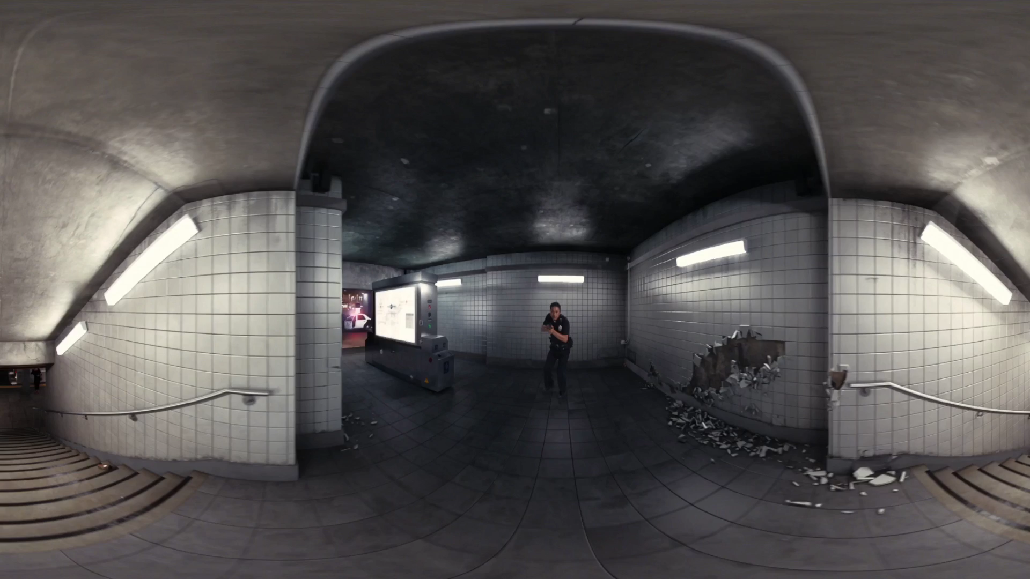

Slide 7
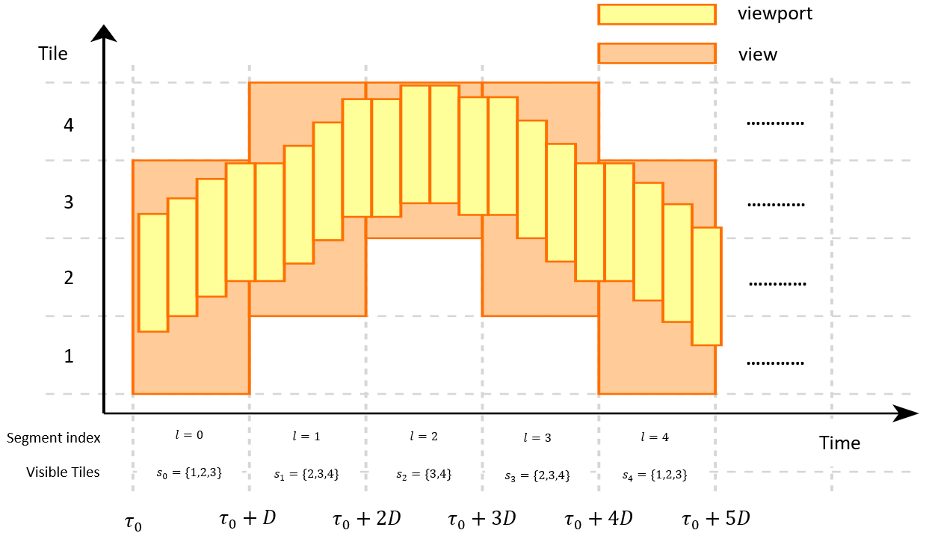
Tiling and segment length is up to us
Navigation graph is about view transitions
View: union of viewports within one segment
Nodes: {Set of Tiles, Segment index}
Edges: {Weight function (probability of from one node to the next)}

Slide 8
Item | W0 | W1 | W2 | W3 | W4 | W5 | W6 | - | W7 | W8 | W9 | W10
[Deadline] Research Proposal | 6-11
RQ 1: Finding data sets
RQ 1: Generating a framework
RQ 2: Research mathematical foundation of NGs
RQ 2: Develop Python NG generation tool
RQ 2: Test and validate the NG generation tool
RQ 3: Literature review on Markov Chains
[Deadline] Draft Paper |  |  |  |  |  | 11-12
RQ 3: Develop Python visualization tool for NGs
RQ 3: Characterize NGs
MQ: Combine RQs
MQ: Conclude MQ
Proofread
[Deadline] Final Paper |  |  |  |  |  |  |  |  |  |  | 22-01
[Deadline] Presentation |  |  |  |  |  |  |  |  |  |  |  | 29-01

Slide 9
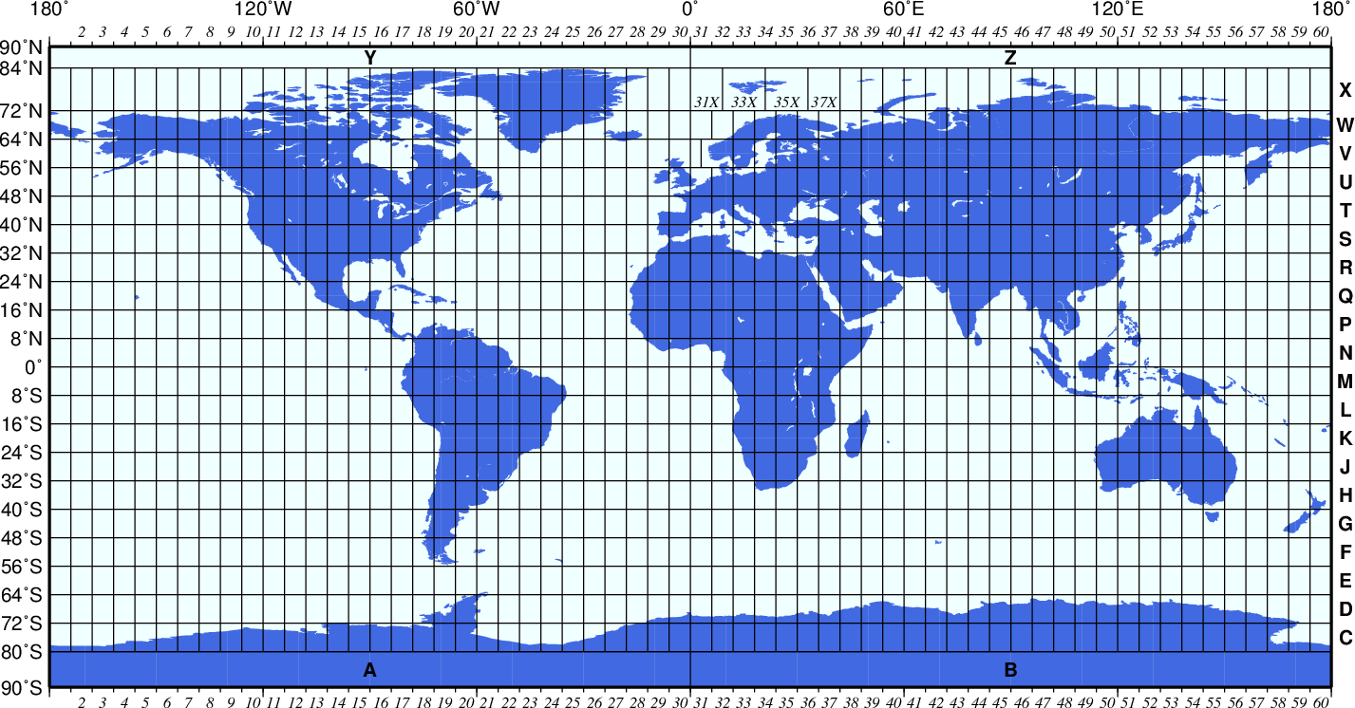
Source: Art of Directional Drilling: UTM COORDINATE SYSTEM (UNIVERSAL TRANSVERSE MERCATOR) (directionaldrillingart.blogspot.com)

Slide 10
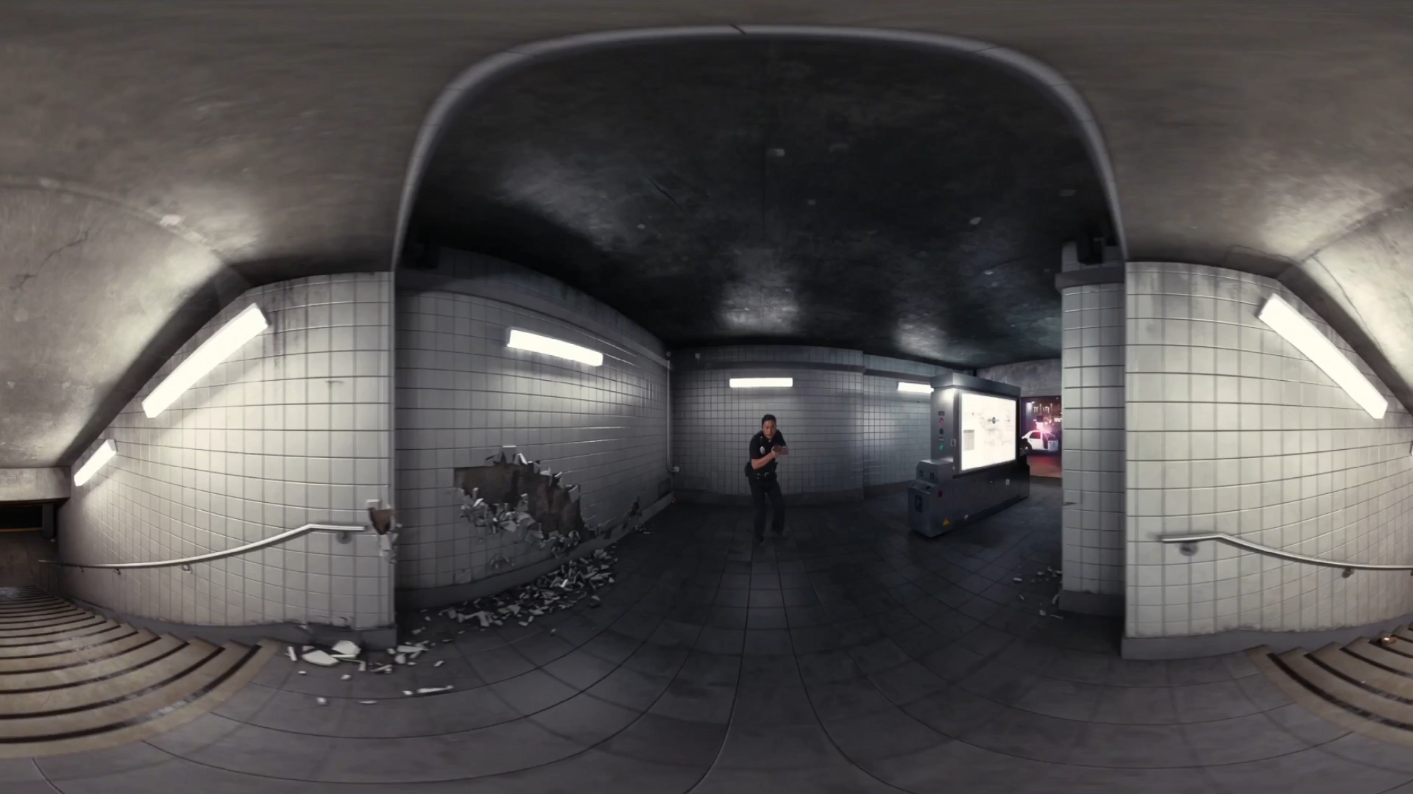

Slide 11
Item | W0 | W1 | W2 | W3 | W4 | W5 | W6 | - | W7 | W8 | W9 | W10
[Deadline] Research Proposal | 6-11
RQ 1: Finding data sets
RQ 1: Generating a framework
RQ 2: Research mathematical foundation of NGs
RQ 2: Develop Python NG generation tool
RQ 2: Test and validate the NG generation tool
RQ 3: Literature review on Markov Chains
[Deadline] Draft Paper |  |  |  |  |  | 11-12
RQ 3: Develop Python visualization tool for NGs
RQ 3: Characterize NGs
MQ: Combine RQs
MQ: Conclude MQ
Proofread
[Deadline] Final Paper |  |  |  |  |  |  |  |  |  |  | 22-01
[Deadline] Presentation |  |  |  |  |  |  |  |  |  |  |  | 29-01

Slide 12
SU (single user) prediction uses a simplified NG without the index
The simplified Navigation Graph for clients is defined as Gc = (S, Ec) where the set S consists of sets of visible tiles s and Ec is the matrix of probabilities of all edges
We will use a segment length (D) of 2 to 4 seconds
(https://bitmovin.com/mpeg-dash-hls-segment-length/)

Slide 13
Video + paper Suzan mentioned (360_icccn20.pdf (ucr.edu))
Time differencing when making NGs?
Horizontal movement is way more common than vertical (which confirms our observations)
Ridge regression is the best according to them, but in NG paper, it specifically mentions better performance than regression techniques (really promising!)
Less movement means better prediction, can we prove that a simpler NG leads to better predictions as well?
User-based customization (adding viewing behaviour to the prediction) helped more than video-based customization (using saliency/heatmaps).
This confirms the results mentioned in NG paper: Combining SU (single user) and CU (cross-user) is the most accurate

Slide 14
indegree/outdegree (source) (edges in and out)
Magnetic Laplacian of directed graphs through KPM (source) (source)
Spectral density
Chebyshev expansion
Stochastic trace estimator
Kernel smoothing
Entropy
Estrada index
Visual analysis (source) (source)
Using Markov chain on graphs (source) (source)

Slide 15
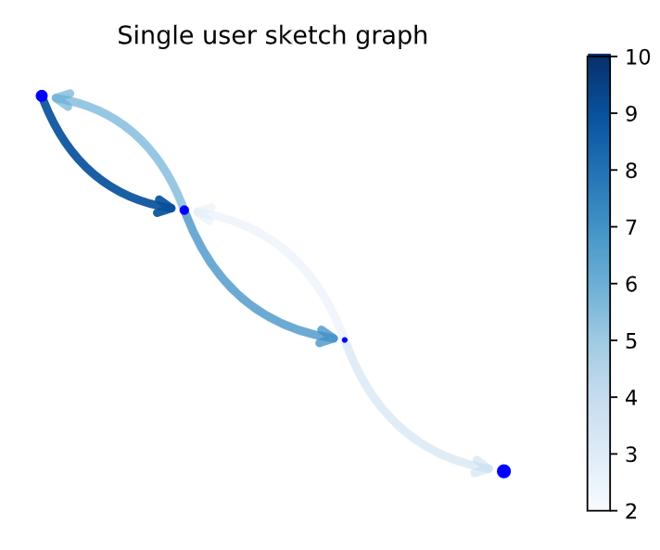

Slide 16
Item | W0 | W1 | W2 | W3 | W4 | W5 | W6 | - | W7 | W8 | W9 | W10
[Deadline] Research Proposal | 6-11
RQ 1: Finding data sets
RQ 1: Generating a framework
RQ 2: Research mathematical foundation of NGs
RQ 2: Develop Python NG generation tool
RQ 2: Test and validate the NG generation tool
RQ 3: Literature review on Markov Chains
[Deadline] Draft Paper |  |  |  |  |  | 11-12
RQ 3: Develop Python visualization tool for NGs
RQ 3: Characterize NGs
MQ: Combine RQs
MQ: Conclude MQ
Proofread
[Deadline] Final Paper |  |  |  |  |  |  |  |  |  |  | 22-01
[Deadline] Presentation |  |  |  |  |  |  |  |  |  |  |  | 29-01

Slide 17
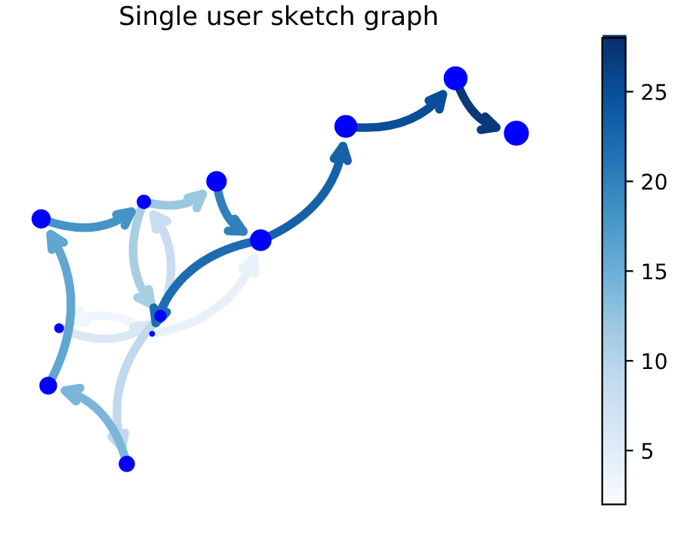

Slide 18
Item | W0 | W1 | W2 | W3 | W4 | W5 | W6 | - | W7 | W8 | W9 | W10
[Deadline] Research Proposal | 6-11
RQ 1: Finding data sets
RQ 1: Generating a framework
RQ 2: Research mathematical foundation of NGs
RQ 2: Develop Python NG generation tool
RQ 2: Test and validate the NG generation tool
RQ 3: Literature review on Markov Chains
[Deadline] Draft Paper |  |  |  |  |  | 11-12
RQ 3: Develop Python visualization tool for NGs
RQ 3: Characterize NGs
MQ: Combine RQs
MQ: Conclude MQ
Proofread
[Deadline] Final Paper |  |  |  |  |  |  |  |  |  |  | 22-01
[Deadline] Presentation |  |  |  |  |  |  |  |  |  |  |  | 29-01

Slide 19
Item | W0 | W1 | W2 | W3 | W4 | W5 | W6 | - | W7 | W8 | W9 | W10
[Deadline] Research Proposal | 6-11
RQ 1: Finding data sets
RQ 1: Generating a framework
RQ 2: Research mathematical foundation of NGs
RQ 2: Develop Python NG generation tool
RQ 2: Test and validate the NG generation tool
RQ 3: Literature review on Markov Chains
[Deadline] Draft Paper |  |  |  |  |  | 11-12
RQ 3: Develop Python visualization tool for NGs
RQ 3: Characterize NGs
MQ: Combine RQs
MQ: Conclude MQ
Proofread
[Deadline] Final Paper |  |  |  |  |  |  |  |  |  |  | 22-01
[Deadline] Presentation |  |  |  |  |  |  |  |  |  |  |  | 29-01

Slide 20
Item | W0 | W1 | W2 | W3 | W4 | W5 | W6 | - | W7 | W8 | W9 | W10
[Deadline] Research Proposal | 6-11
RQ 1: Finding data sets
RQ 1: Generating a framework
RQ 2: Research mathematical foundation of NGs
RQ 2: Develop Python NG generation tool
RQ 2: Test and validate the NG generation tool
RQ 3: Literature review on Markov Chains
[Deadline] Draft Paper |  |  |  |  |  | 11-12
RQ 3: Develop Python visualization tool for NGs
RQ 3: Characterize NGs
MQ: Combine RQs
MQ: Conclude MQ
Proofread
[Deadline] Final Paper |  |  |  |  |  |  |  |  |  |  | 22-01
[Deadline] Presentation |  |  |  |  |  |  |  |  |  |  |  | 29-01

Slide 21
Item | W0 | W1 | W2 | W3 | W4 | W5 | W6 | - | W7 | W8 | W9 | W10
[Deadline] Research Proposal | 6-11
RQ 1: Finding data sets
RQ 1: Generating a framework
RQ 2: Research mathematical foundation of NGs
RQ 2: Develop Python NG generation tool
RQ 2: Test and validate the NG generation tool
RQ 3: Literature review on Markov Chains
[Deadline] Draft Paper |  |  |  |  |  | 11-12
RQ 3: Develop Python visualization tool for NGs
RQ 3: Characterize NGs
MQ: Combine RQs
MQ: Conclude MQ
Proofread
[Deadline] Final Paper |  |  |  |  |  |  |  |  |  |  | 22-01
[Deadline] Presentation |  |  |  |  |  |  |  |  |  |  |  | 29-01

Slide 22
Item | W0 | W1 | W2 | W3 | W4 | W5 | W6 | - | W7 | W8 | W9 | W10
[Deadline] Research Proposal | 6-11
RQ 1: Finding data sets
RQ 1: Generating a framework
RQ 2: Research mathematical foundation of NGs
RQ 2: Develop Python NG generation tool
RQ 2: Test and validate the NG generation tool
RQ 3: Literature review on Markov Chains
[Deadline] Draft Paper |  |  |  |  |  | 11-12
RQ 3: Develop Python visualization tool for NGs
RQ 3: Characterize NGs
MQ: Combine RQs
MQ: Conclude MQ
Proofread
[Deadline] Final Paper |  |  |  |  |  |  |  |  |  |  | 22-01
[Deadline] Presentation |  |  |  |  |  |  |  |  |  |  |  | 29-01

